Slide 1

DH- Parameters:
Two links are there- link i and
link i-1.
Frame i is attached to link i
and frame i-1 is attached to
link i-1.
a_{i} (link length): It is the distance
along X_{i} from the point of
intersection between Z_{i-1} and X_{i}
to the origin of frame i.
α_{i} (link twist): It is the angle between
Z_{i-1} and Z_{i} measured about X_{i}.
di (joint distance): It is the distance along
Z_{i-1} from the origin of frame i-1 to the point
of intersection between Z_{i-1} and X_{i}.
θ_{i} (joint angle): It is the angle between
X_{i-1} to X_{i} measured about Z_{i-1}.

Slide 2



Determination of position and orientation of frame i with respect to i-1
Assuming frame i to be aligned with frame i-1 initially, what are the transformations it has to undergo to reach its current position and orientation?
$$∝i$$
Z_{i}
Z_{i}
X_{i}
Z_{i}
X_{i}
1. Rotation of θ_{i} about Z_{i-1} (X_{i-1} parallel with X_{i})
2.Translation of d_{i} along Z_{i-1} (X_{i-1} aligns with X_{i})
X_{i}
Z_{i}
a_{i}
Z_{i-1}
3.Translation of a_{i} along X_{i} (origin of frame i-1 same as
that of frame i)
d$i$
X_{i-1}
4. Rotation of α_{i} about X_{i} (Z_{i-1} aligns with Z_{i})
$$θi$$
All rotations and translations about the rotated frames; so Euler angle rotation
X_{i-1}
X_{i}

Slide 3

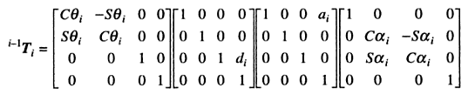
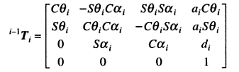
Since Euler angle rotation, individual transformation matrices are to be post-multiplied
Many texts are from Robotics and Control by Nagrath and Mittal

Slide 4
y₁
L2
y₂
DH Parameters
L2
x₁
x₂
z₁
z₂
Link i | a_{i} | α_{i} | d_{i} | θ_{i} | Joint Var
1 | 0 | 90º | L₁ | 0 (θ1) | θ1
2 | L₂ | 0 | 0 | 0 (θ2) | θ2
L1
L1
z₀
y₀
x₀

Slide 5


Link 1 | a₁ | α₁ | d₁ | θ₁
1 | 0 | 90º | L₁ | 0 (θ1)
Putting i=1,
Link i | a_{i} | α_{i} | d_{i} | θ_{i} | Joint Var
1 | 0 | 90º | L₁ | 0 (θ1) | θ1
2 | L₂ | 0 | 0 | 0 (θ2) | θ2
Putting i=2,

Slide 6
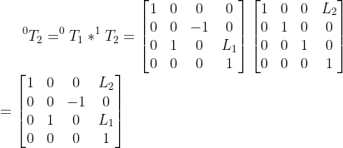
y₁
L2
y₂
L2
x₁
x₂
z₁
z₂
L1
L1
z₀
y₀
X₂
Y₂
Z₂
origin₂
x₀
By mere observation, from geometry

